Slide 1
Basic Computer Concepts The Internet
Lecture 3 – Prepared by Nicolas Bergeron
Modified by Ronald Raphael

Slide 2
Outline
Computer Network
The Internet
Web Browsers
Malware
Viruses
Phishing Attacks
Ransomware
Cloud Computing
Intellectual Property

Slide 3
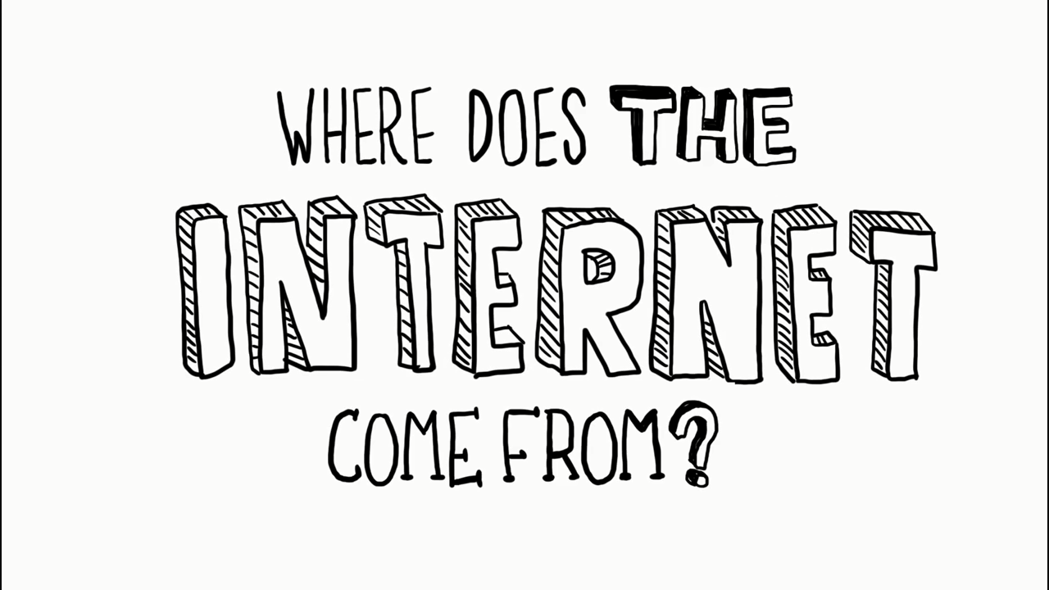
The Internet
https://www.youtube.com/watch?v=jKA5hz3dV-g

Slide 4
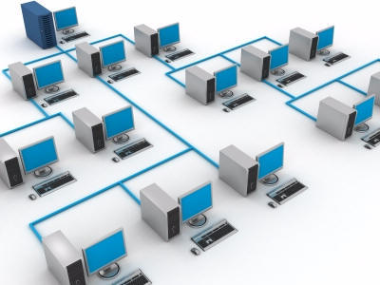
Computer Network
A group of computers connected together sharing resources, data and/or storage. Computers in a network are able to communicate with each other through protocols.
Local Area Network (LAN)
Can range from a small office to thousands of computers spread through multiple buildings
Wide Area Network (WAN)
When a LAN is expanded to encompass many geographic locations such as the Internet!
Source: http://cksolutions.ie/what-is-a-computer-network

Slide 5

The Internet
Computer communicates with each other using the TCP/IP protocol
Each Computer has a unique IP Address eg: 206.167.212.88
Websites are hosted on a Web Server containing the website’s files (HTML, CSS, Images, …)
We can connect to website and retrieve its files using a Web Browser
Source: http://www.ndtv.com

Slide 6

Using a Web Brower
The most common web browsers are: Firefox, Chrome, Safari, Edge
Tracking – Privacy mode
When connecting to a website, information about you is sent to the site’s server (IP address, browser information, browsing decisions)
For example, if you are shopping for a computer, you may “coincidently” see computer adverts on your social media page
Most browser come with a Private mode, limiting the amount of data exposed to websites
Public / Shared Computers
Be careful when using computers in a Web Café or other public computers
Some website will stay logged-in after you leave
Private mode is again recommended on shared computers

Slide 7

Search Engines
If you don’t know the URL of a site you want to visit you can use a search engine to locate information.
Search engines use a program called a spider or bot to compile databases that are indexed by keywords
When you enter a keyword in a search engine, it searches the database to find webpages that include those keywords
Results are displayed as a list of links to the webpages
Google is famous for tracking everything you search
DuckDuckGo is less intrusive

Slide 8
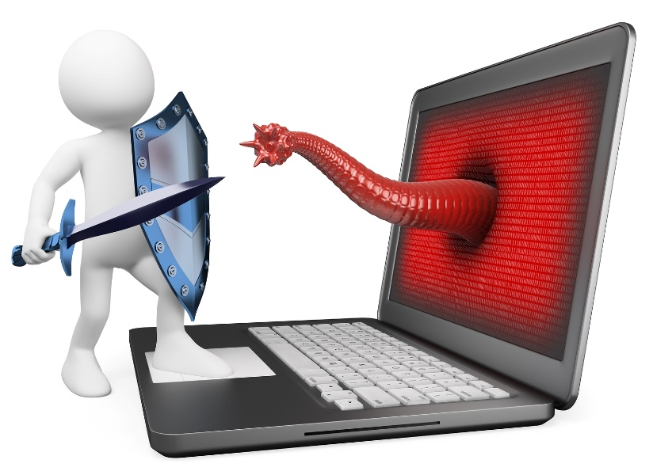
Malware and other internet treats
Phishing attacks and clicking hyperlinks:
If you are not sure where the hyperlink is targeted
Your bank will not send you emails asking you to login
May be an attacker trying to steal your login information
Viruses: Programs accessing your Computer Resources
Often coming from executable files in emails (eg: funnyPic.jpg.exe)
Social Engineering
Someone pretending to be the IT departments, asking to run a few commands on computer
Someone calling you, asking to confirm some personal information

Slide 9
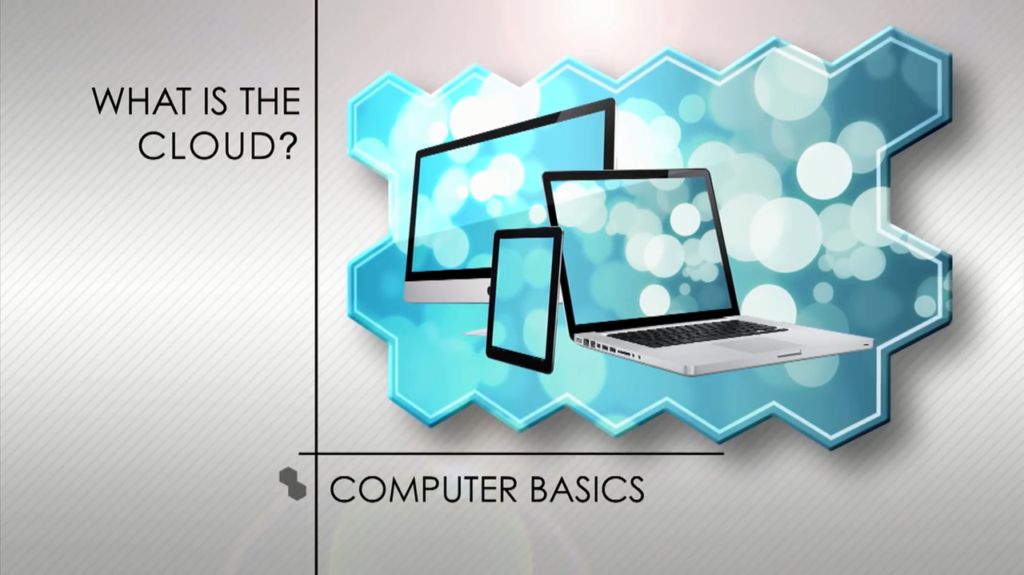
The Cloud
https://www.youtube.com/watch?v=gu4FYSFeWqg

Slide 10
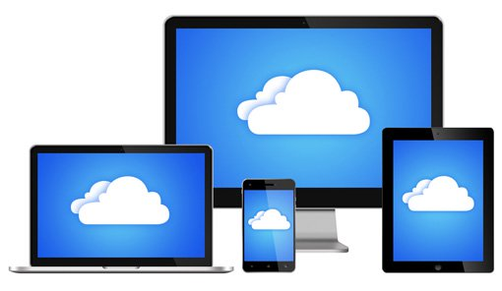
Cloud Storage
It can be convenient to store your important files on the Internet
Files synchronized across multiple devices
Office 365 comes with a OneDrive account (Microsoft Cloud Storage)
Other providers: Dropbox, Google Drive, iCloud

Slide 11

Intellectual Property
Content on the web is regulated by Intellectual Property laws
Any content may come with a License, which protects the author
If you distribute contents you find online, you should make sure you do not violate the content’s license.
Some content is licensed “Public Domain”
Stock Photo websites allow purchasing the rights to use images

Slide 12

Fair Use
U.S. copyright law allows portions of copyrighted works to be used without obtaining permission if that use is a fair use.
Four factors usually determine fair use:
The purpose and character of the new work
The nature of the copyrighted work
The amount and substantiality of the portion used in relation to the copyrighted work as a whole
The effect of the use on the potential market, or value, of the copyrighted work

Slide 13

Avoiding Plagiarism
Failure to cite the source of material you use is called plagiarism.
Claiming someone else’s work as your own is a serious legal violation.
Be sure to properly reference the sources of works that you use.
You must obtain the copyright holder’s permission to use work in a way that falls outside of fair use.

Slide 14
References
Goodwill Community Foundation - Learn Free
https://www.gcflearnfree.org

